Slide 1
Beers and Breweries Analysis
Tamas Toth

Slide 2
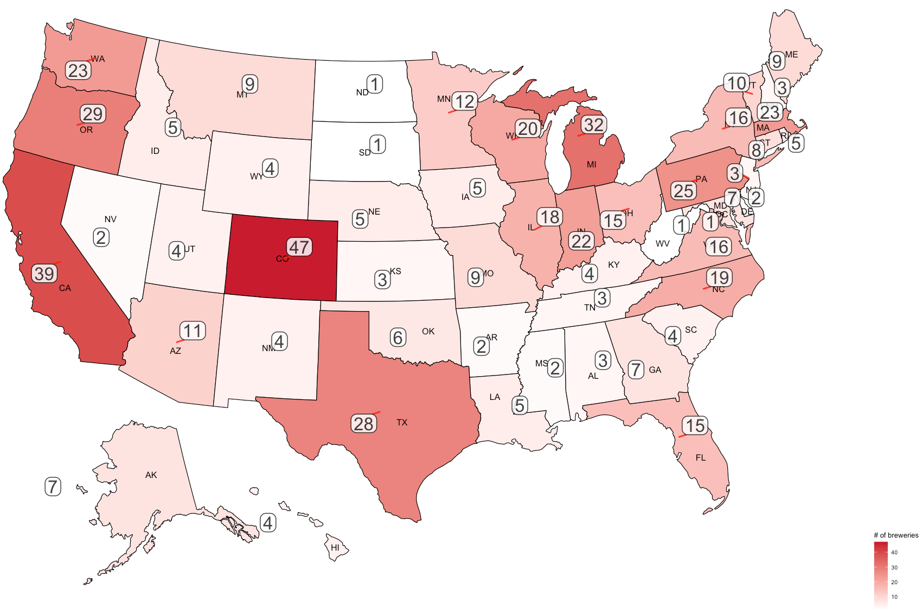
Location is key to win on the market
Number of Budweiser breweries by US states
∑ breweries = 558
99 different types of beers
60 unique beers just in CO

Slide 3
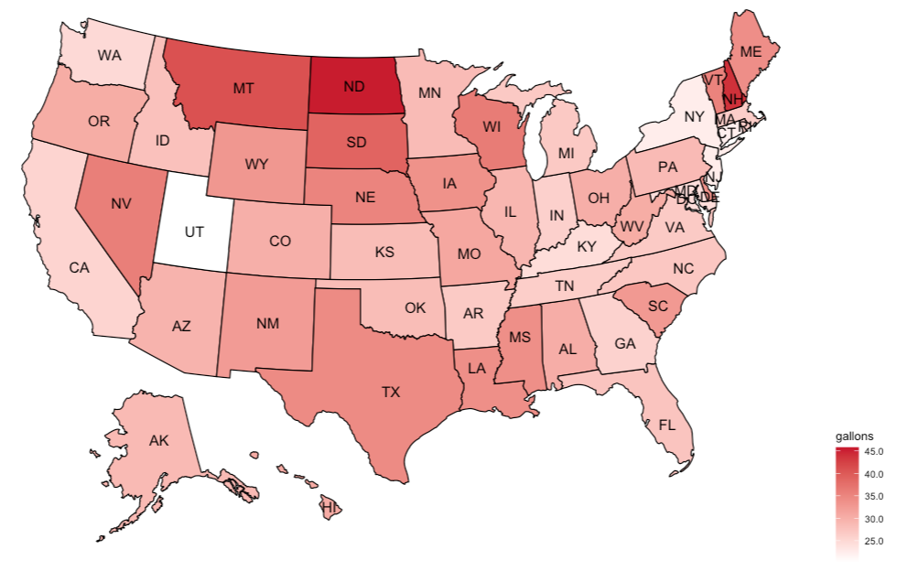
Increase presence in high beer consuming states
Beer Consumption by State per Capita
* Data source: https://beerinfo.com/beer-consumption-by-state-per-capita/

Slide 4
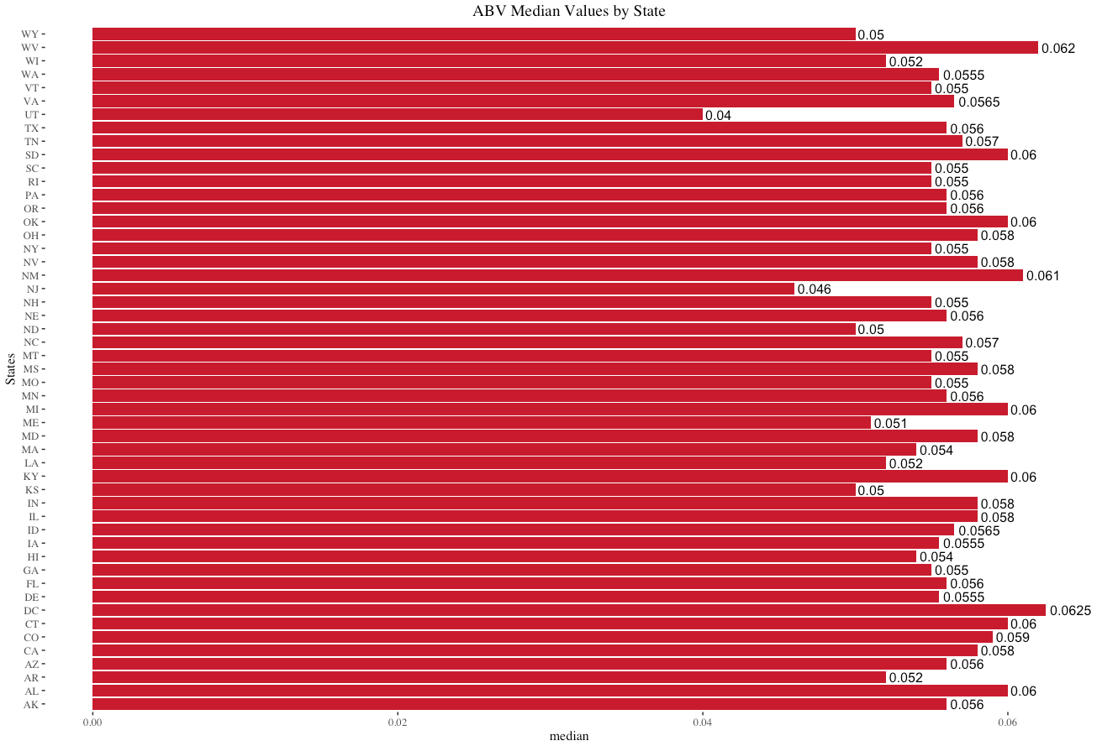
Median Alcohol Content for each state

Slide 5
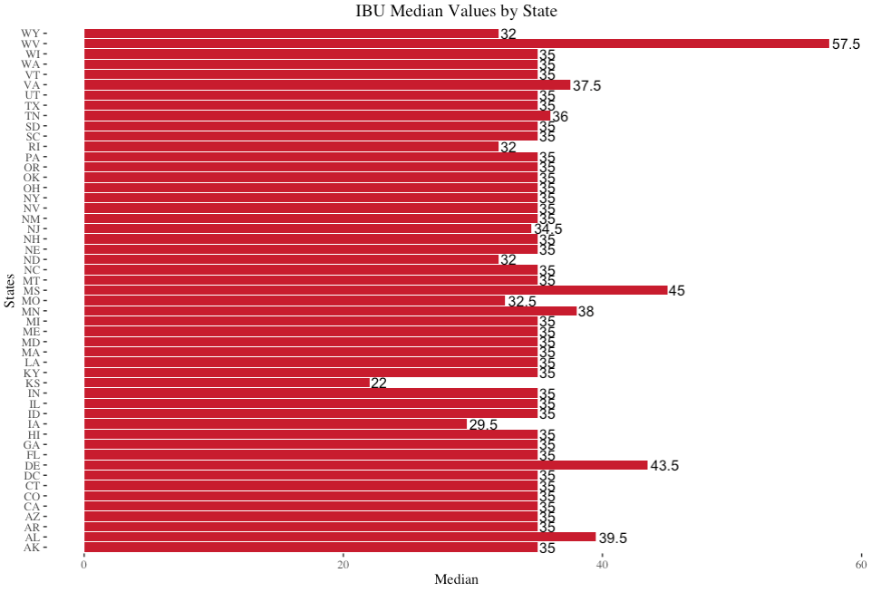
Median IBU value for each state

Slide 6
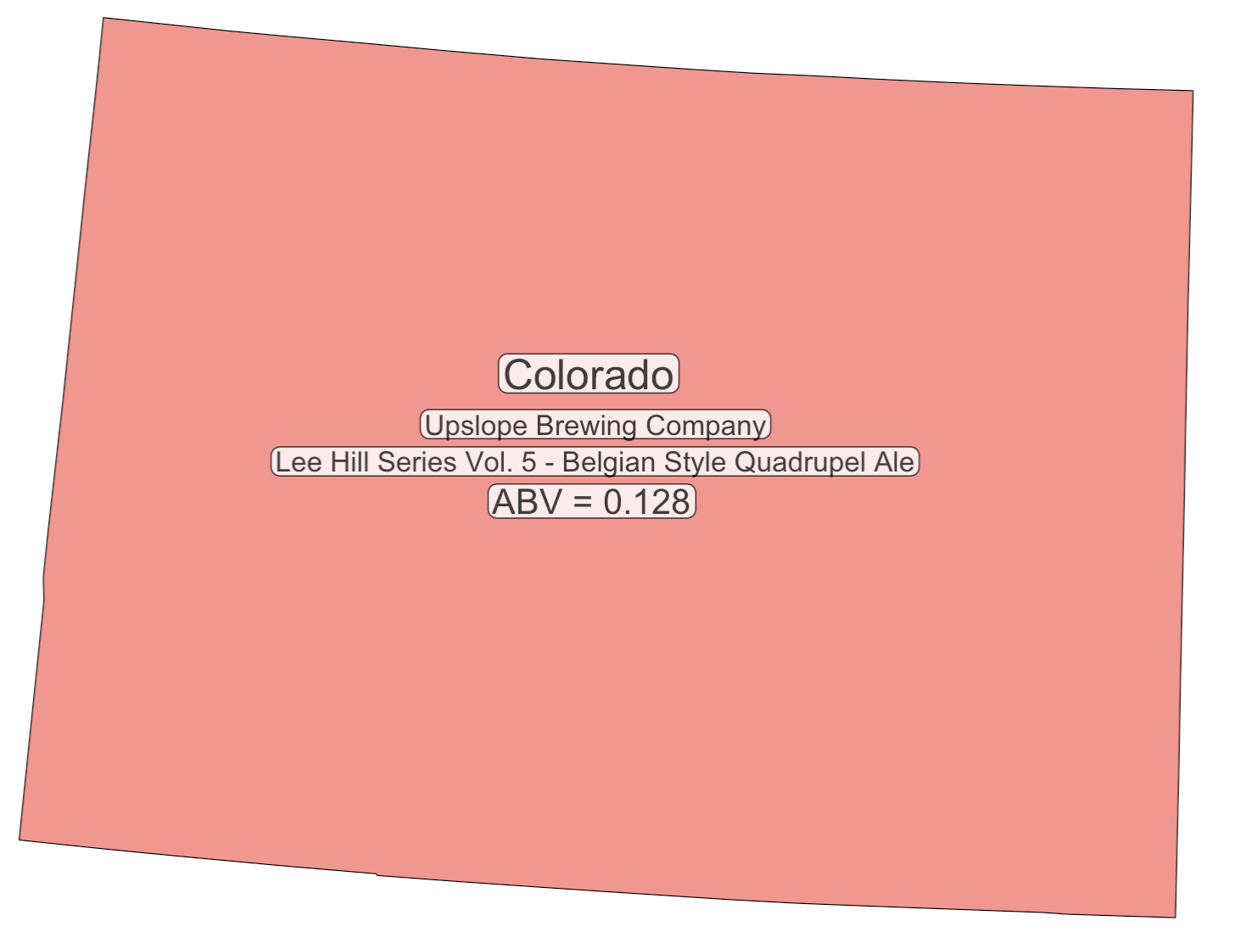
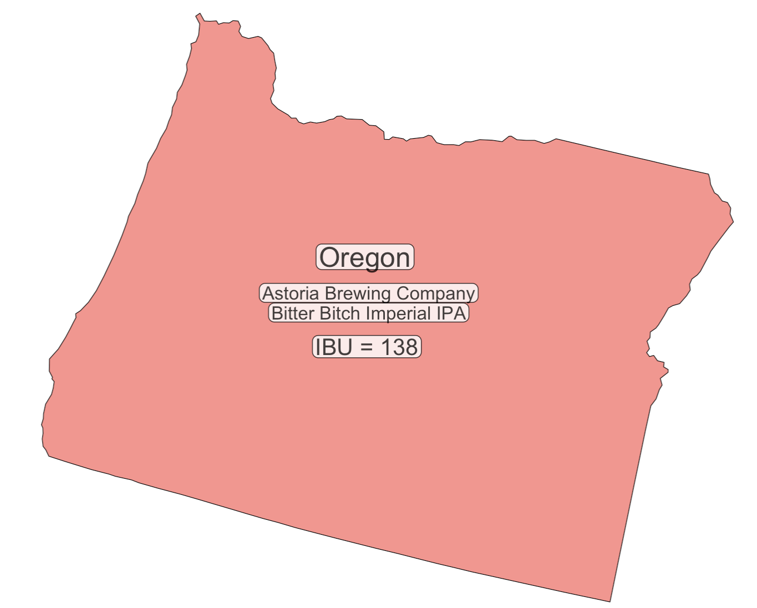
State that has the maximum alcoholic (ABV) vs the most bitter (IBU) beer

Slide 7
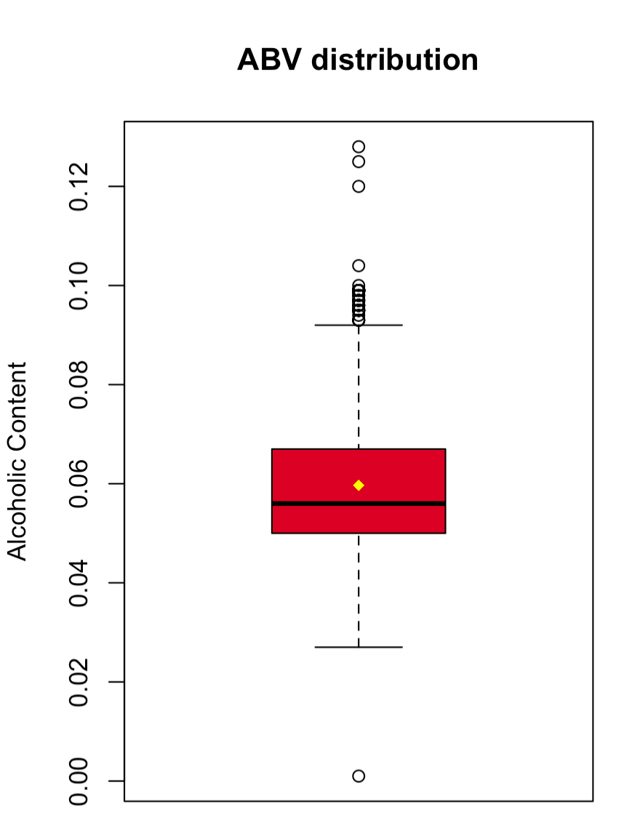
Product portfolio description based on alcohol content
Alcohol content is ranging between 0.001 and 0.128
25% of the products alcohol content is less than or equal to 0.05
50% of the products alcohol content is above and below of 0.056
75% of the products alcohol content is less than or equal to 0.067
Average alcohol content of the products is 0.059
Product portfolio is mostly comprised of mild alcohol content beers

Slide 8
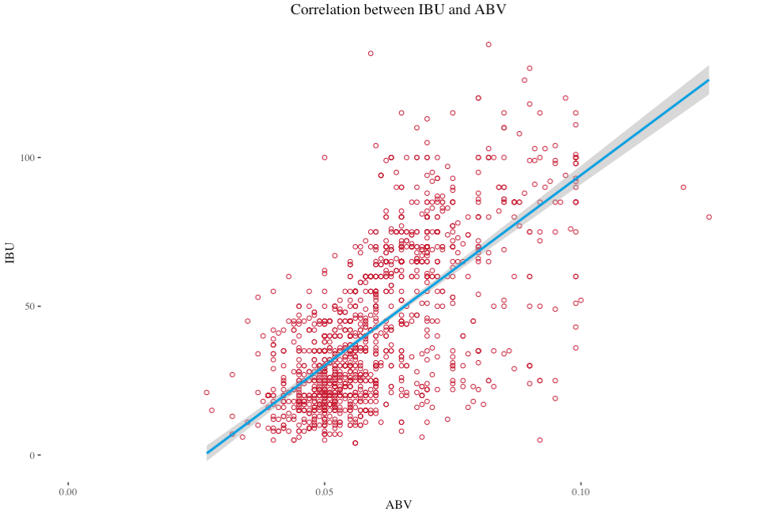
Relationship between the beer bitterness and alcohol content
There is a positive linear relationship between ABV and IBU.
The beer alcohol content increase is associated with the bitterness.

Slide 9
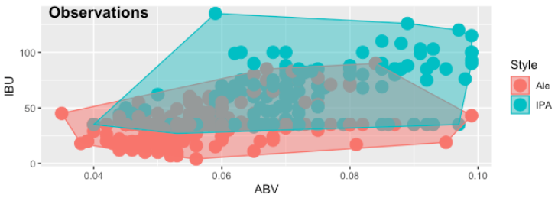
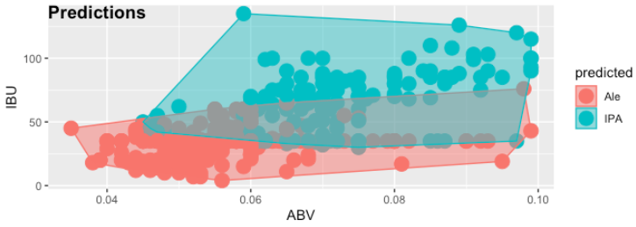
Difference between IBU & ABV for IPA and ALE
963 Ale style beers
576 IPA style beers
Predictive model accuracy ~83%
The model generalizes well to predict beer style (IPA vs Ale) based on IBU and ABV values

Slide 10
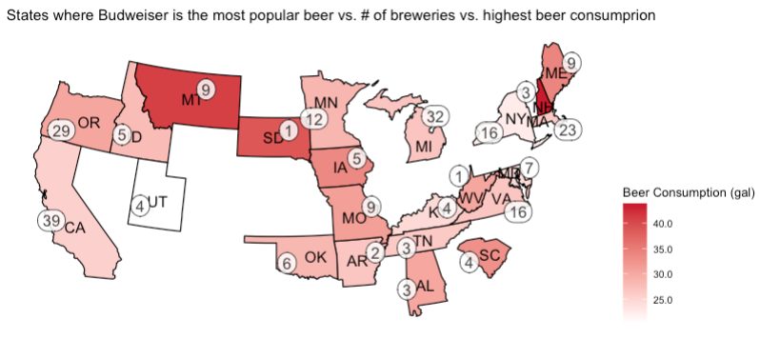
Popular with opportunities to grow
Budweiser is the most popular beer in 23 states.
Increase presence in those states

Slide 11
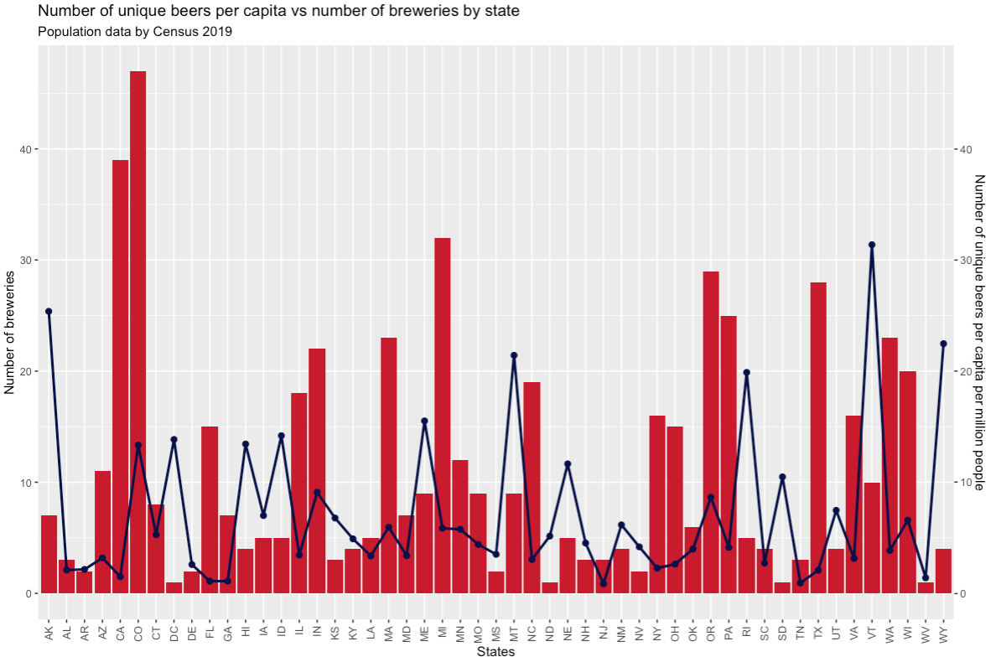

Number of unique beers per capita vs number of breweries by state

Slide 12
Key takeaways
CO has the greatest number of breweries.
Carry out a market analysis in ND, NH, and MT to better understand potential market opportunities to increase sales given the high amount of beer consumption.
CO is producing the highest alcohol content beer.
OR is producing the most bitter beer.
Product portfolio is mostly comprised of mild alcohol content beers.
We can observe a relationship between alcohol content and bitterness.
Study the beer styles to see if there is a need to reclassify some of them from IPA to Ale or vice versa.
Increase presence in those states where their beer is the most popular by increasing the number of breweries.
Increase the variety of beers in those states where the number of unique beers are low per capita per million people.

Slide 13
YouTube
https://youtu.be/LxYCKh0nInM

Slide 14
Q & A
ttoth@smu.edu

Slide 15
Backup

Slide 16
Number of Budweiser breweries by US states
AK | AL | AR | AZ | CA | CO | CT | DC | DE | FL | GA | HI | IA | ID | IL | IN | KS
7 | 3 | 2 | 11 | 39 | 47 | 8 | 1 | 2 | 15 | 7 | 4 | 5 | 5 | 18 | 22 | 3
KY | LA | MA | MD | ME | MI | MN | MO | MS | MT | NC | ND | NE | NH | NJ | NM | NV
4 | 5 | 23 | 7 | 9 | 32 | 12 | 9 | 2 | 9 | 19 | 1 | 5 | 3 | 3 | 4 | 2
NY | OH | OK | OR | PA | RI | SC | SD | TN | TX | UT | VA | VT | WA | WI | WV | WY
16 | 15 | 6 | 29 | 25 | 5 | 4 | 1 | 3 | 28 | 4 | 16 | 10 | 23 | 20 | 1 | 4

